Slide 1
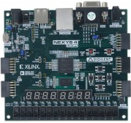
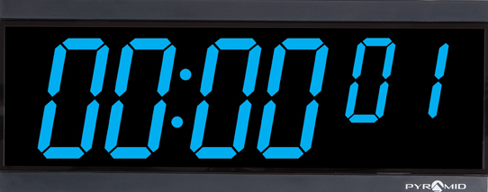
Motion Awareness Study Timer/Rotating Circuit Blinking-LED Core
David Edeni

Slide 2
My Original Plan:
Building a Motion-Aware Study Timer
Motion Aware Study Timer: FPGA Study Timer that tracks focused study time using motion detection. This timer pauses when motion is detected and displays focused timed on the Nexys DDR-4’s seven-segment display and over a UART interface such as PUTTY.
Project Goal: Display FPGA sensor interfacing, fixed-point motion processing, timing logic, module control, and UART communication.
Required Hardware: Nexys DDR-4 FPGA Board, IMU via I2C or SPI, seven-segment display, USB-UART connection, and optional pushbuttons.
Required Software: Vivado and Vitis

Slide 3
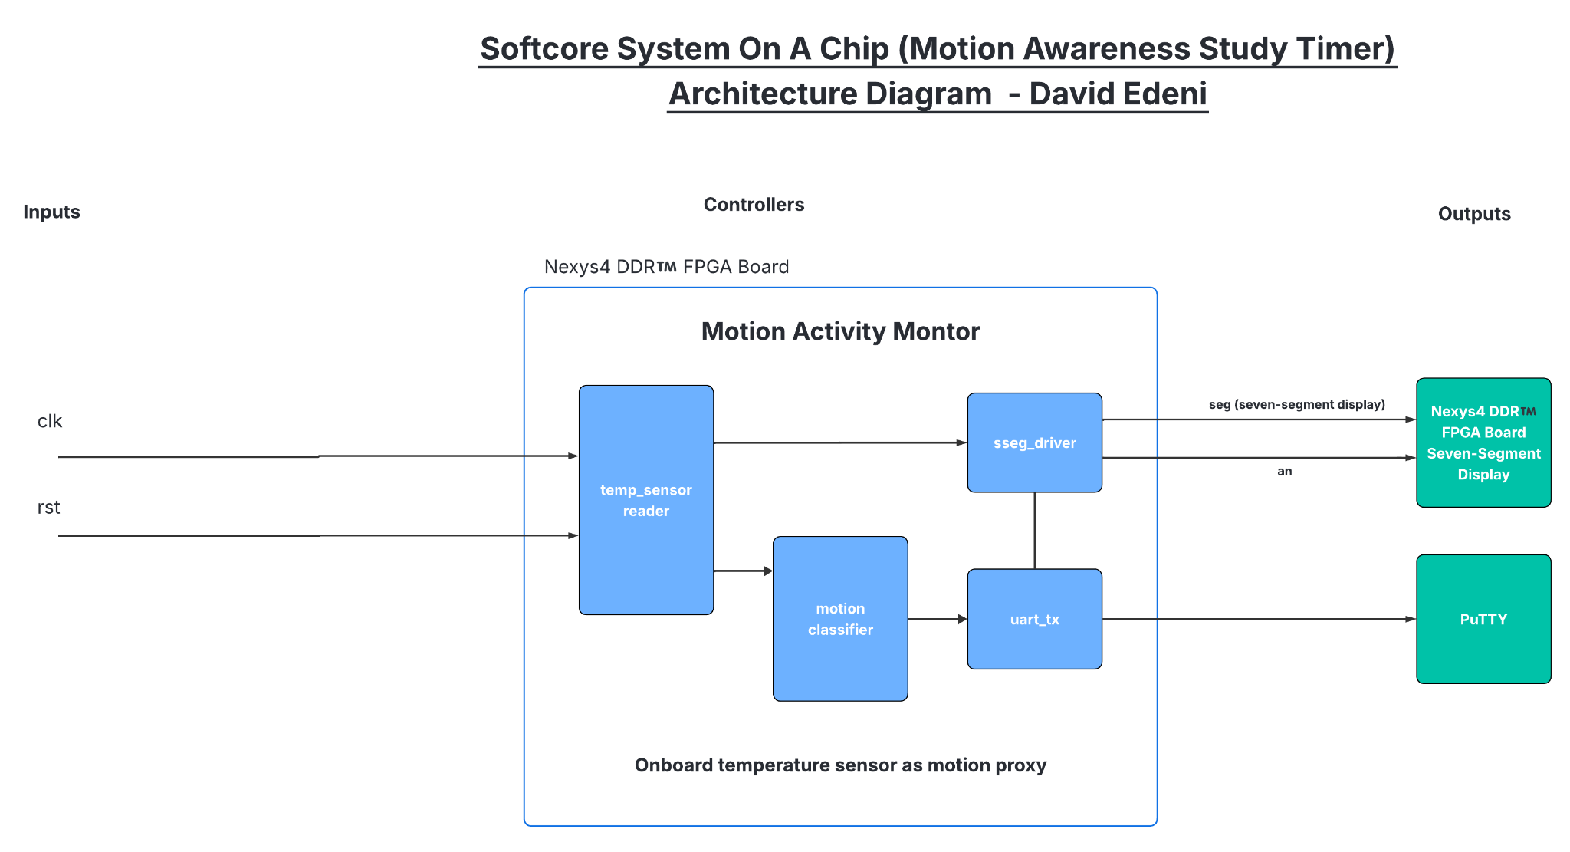
Motion Awareness Study Timer System Architecture
IMU Interface -> Motion Filter Processing -> Focus Timer Logic -> Seven-Segment Display -> UART Logging

Slide 4
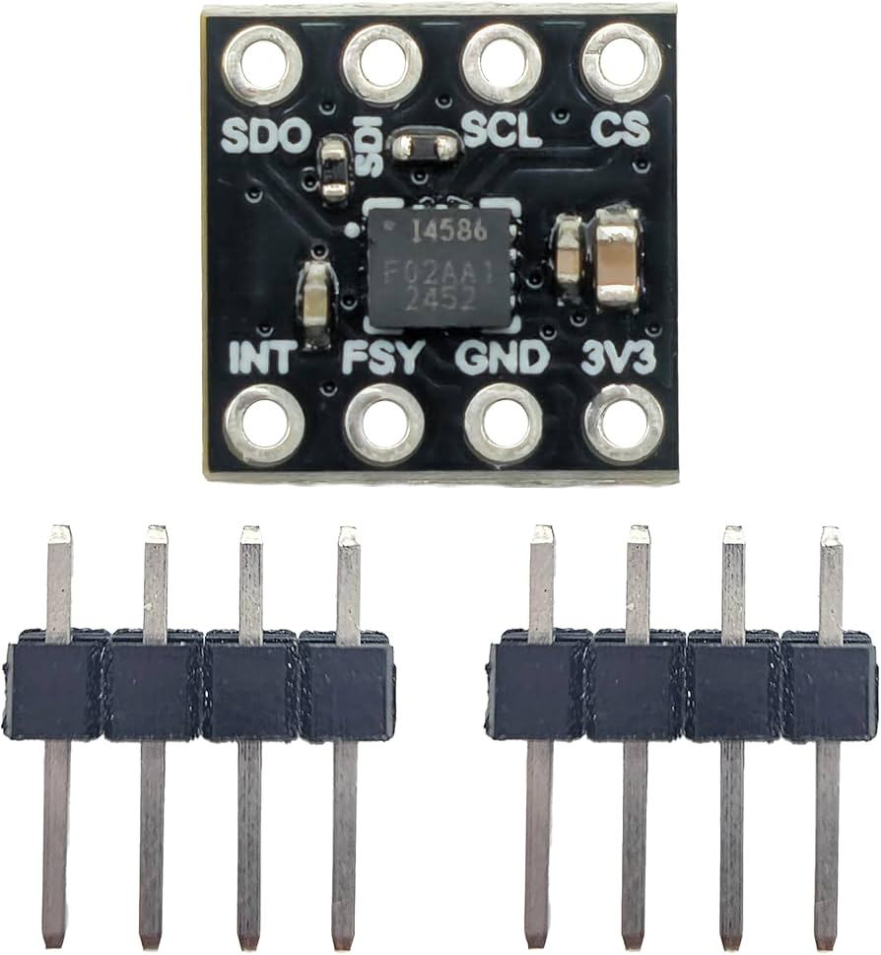
IMU Interface:
Implementation I2C/SPI protocol via Verilog modules.
The modules configure sensor registers; read X, Y, and Z acceleration detected from board peripherals; and output signed fixed-point data.

Slide 5
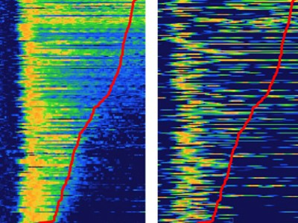
Motion Filter Processing:
The process of computeting acceleration magnitude, RMS (root mean-squared), or other distance measurement values.
Read movement from board
sensors are filtered and compared
against a threshold.
The sensors return still/moving
signal that is interpreted by the board.

Slide 6
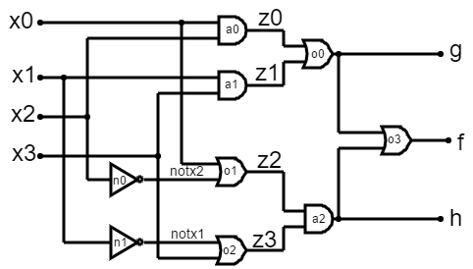
Focus Timer Logic:
Counts total elapsed time.
Counts focused time when still.
Generates one-second tick.
Computes focus percentage.

Slide 7
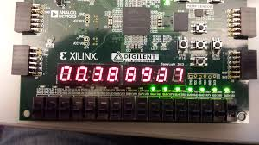
DDR4 FPGA Seven-Segment Display:
Displays focused minutes.
Performs digit multiplexing.
Implements segment decoding logic.

Slide 8
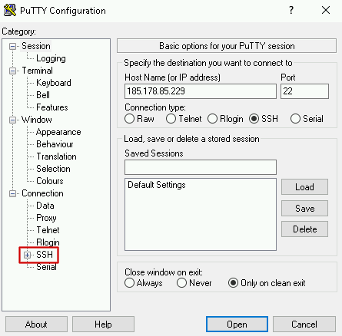
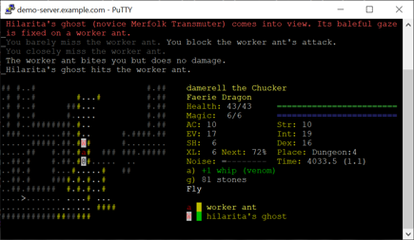
UART Logging:
A UART interface such as PUTTY
shows periodic summaries of elapsed
time, focused time, and motion statistics.

Slide 9

Implementation Steps:
Verify the sensor interface works properly.
Build the following required Verilog modules: a motion filter, focus timer, and an sseg display.
Implement and synthesize the Verilog modules in Vivado and Vitis.
Connect a UART interface such as PUTTY to the project.
Integrate and test the project.

Slide 10
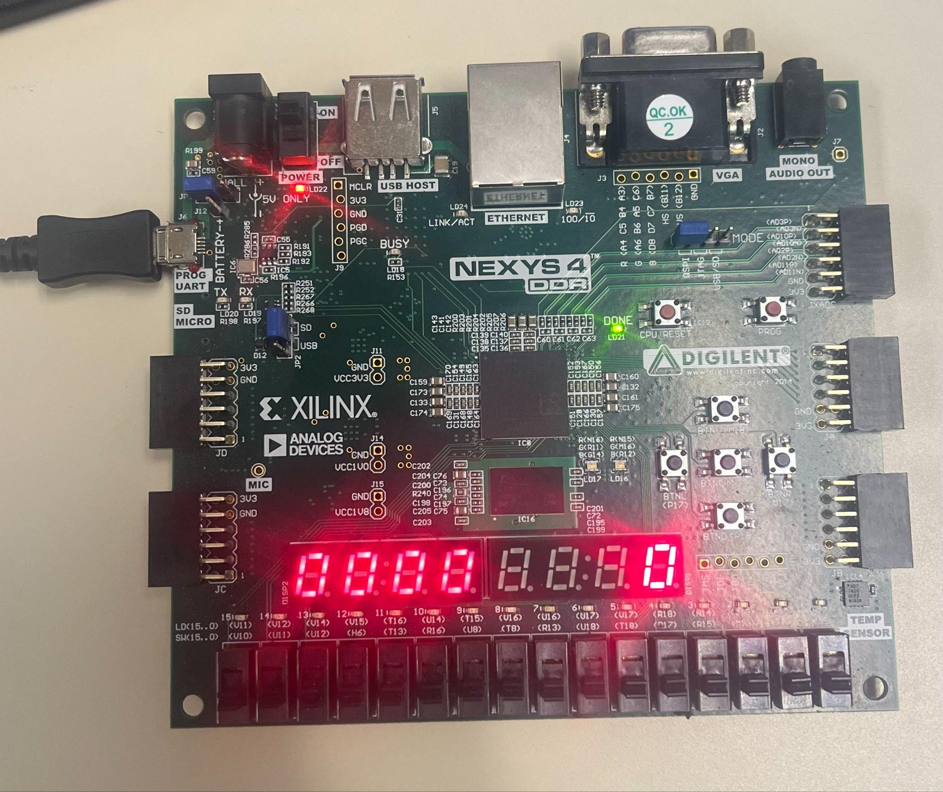
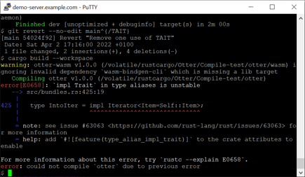
Expected Outputs:
The Nexys4 DDR™ FPGA Board shows focused time.
A UART interface such as PUTTY prints time summaries every few seconds.

Slide 11
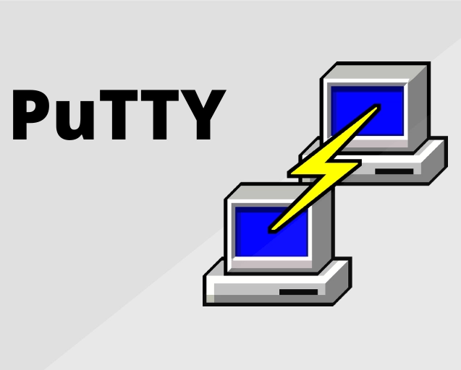
What I actually got…
The Nexys4 DDR™ FPGA Board Seven-Segment output would only display the following and not UART output was ever produced.

Slide 12

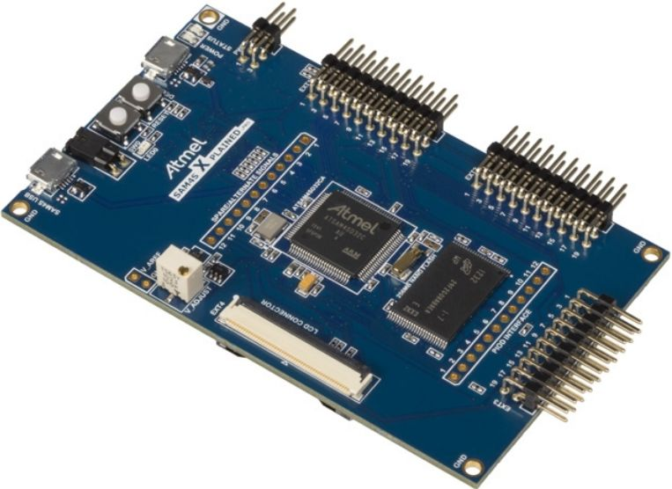
Conclusion:
I built a compact, realistic FPGA System.
In my opinion, DDR4 Boards are not the best for UART simulation. I literally built a temperature sensor in Embedded Systems that properly displayed to a UART (PUTTY terminal).
Atmel Studio Boards such as the Atmel SAM4L8 Board are better equipped for temperature sensing and UART simulation.

Slide 13
Sources:
“Digilent – Start Smart, Build Brilliant.” Digilent.com, digilent.com/
“Atmel Products.” Microchip.com, 2025, www.microchip.com/en-us/about/corporate-overview/acquisitions/atmel.
Google. “Google Images.” Google.com, Google, images.google.com/.

